Slide 1
Centroid Decomposition
Priyanshu Das
AM.EN.H4CSE14003

Slide 2
Focus of Presentation
What is Centroid Decomposition?
How is Centroid Decomposition useful?
What is the time complexity of Centroid Decomposition?
How do we implement Centroid Decomposition?
Where can we apply Centroid Decomposition?

Slide 3
What is Centroid Decomposition?
Two parts : Centroid and Decomposition

Slide 4
Centroid of a Tree
A node in a tree is a centroid if and only if, upon removing that node, the resulting forest has all trees with the following property :
Size(tree) <= (size of original tree) / 2
There may be either one or two centroids in any given tree

Slide 5
Decomposition of a Tree
By decomposition, we mean a bijective mapping of nodes in the original tree, to that of the decomposed tree
The nodes that are adjacent in the decomposed tree may not necessarily be adjacent in the original tree
The objective is to make the storing and retrieval of data (ie queries) more efficient, by giving some structure to the tree (depending on the decomposition)
Thus, in Centroid Decomposition, we attempt to decompose the tree in such a way that the height of the decomposed tree is minimized and the following property is simultaneously fulfilled : In the decomposed tree; for all nodes n, all of n’s descendants from one child must pass through n in order to reach n’s descendants from other children of n.

Slide 6
Steps for Centroid Decomposition
Find the centroid for the original tree
Remove the centroid in the original tree, this becomes the root in the decomposed tree
Removing the centroid in the original tree reduces the original tree to a forest of trees
Repeat step 1 to 3 for every tree in the forest. Every time a centroid is found, it becomes the descendant of the centroid responsible for disconnecting it’s tree
This process terminates when there are no more nodes left after removing a centroid
The tree thus formed is the centroid tree

Slide 7
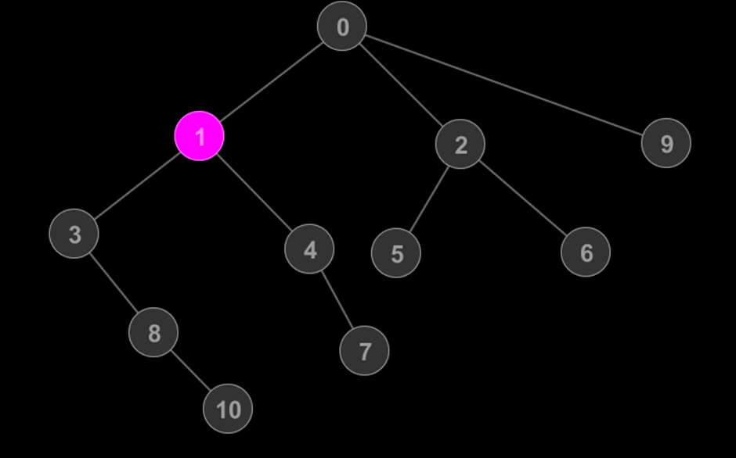
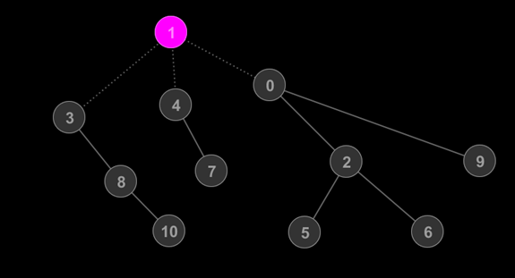
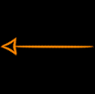
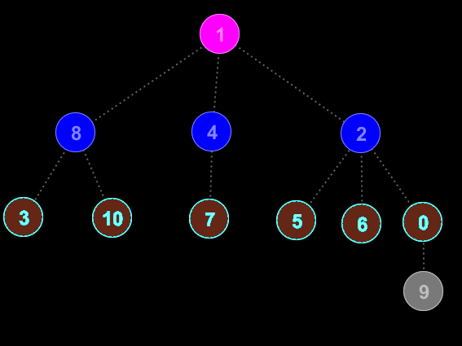
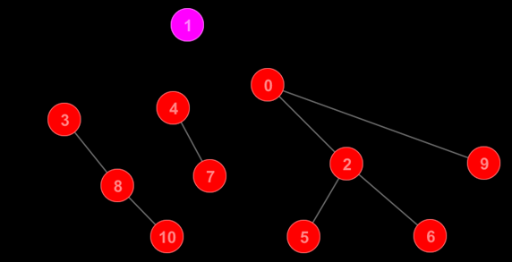

Slide 9
Properties of Centroid Tree
Contains all nodes of original tree
Height of tree is at max log(N)
Path from A->B can be broken down to A-> C -> B, where C is the lca(A, B) in the centroid tree
Effectively, we decompose the tree into Nlog(N) paths, where any path in the original tree is a concatenation of two such paths

Slide 10
How is Centroid Decomposition Useful?
To effectively “compress” the height of a tree
Maximizing efficiency by maximizing the information stored in each “information hub”, consequently reducing the number of nodes required to be examined for a query
Since the number of ancestors of a certain node are maximum log(N) in the tree, upon updating the node, number of updates required to the “information hubs” related to that node is minimized

Slide 11
Analysing the Time Complexity of Centroid Decomposition

Slide 12
Finding the centroid
Start from a node
Either node is centroid, or centroid is in one of the subtrees of node
If not centroid, then go to the child with the largest size
No node is visited twice
After each step, the number of nodes unprocessed is decreased by 1
Time Complexity = O(N)

Slide 14
Decomposing the Tree
After finding centroid, tree split into forest
Each tree has max size = n/2
Complexity of finding size of each tree = O(size)
Complexity of finding centroid for each tree = O(size)
=> n + x*(n/x) + x²*(n/x²) + … x^{k}*(n/x^{k})
=> O(nlog(n))
∴ Time Complexity = O(N*log(N))

Slide 17
Implementing Centroid Decomposition

Slide 18
Main Components of Decomposition
Pre-processing
Decomposition
Finding the level of each node in the original tree
For each node storing the distance from that node to each of it’s 2^{k} ancestors, where 0 <= k <= log(N)
This is used in the LCA helper function which determines the LCA of two nodes in the original tree
Distance function, which finds the distance between two nodes in the original tree, with the help of the LCA function
Finding the number of nodes in the tree
Finding the centroid of the tree
Deleting the connections to and from the centroid
Decomposing the resulting trees
Forming the connection between the centroids of the children trees to the parent centroid

Slide 19
Pre-processing
Distance to Ancestors
Example Code
We store log(N) values for each node, corresponding to each of their 2^{k}th ancestor
Memory used = N*log(N)
We use the following recurrence relation to achieve the above : DP[k][n] = DP[k-1][DP[k-1][n]] i.e the 2^{k} th ancestor of n is also the 2 ^{(k-1)} th ancestor of the 2 ^{(k-1)} th ancestor of n
void dfs_p(ll node)
{
for(auto it = conn[node].begin(); it != conn[node].end(); it++)
{
if(*it == DP[0][node])
continue;
DP[0][*it] = node;
level[*it] = level[node]+1;
dfs_p(*it);
}
}
void pre_process()
{
level[0] = 0;
DP[0][0] = 0;
dfs_p(0);
for(ll i = 1 ;i < max_lg ;i++)
for(ll j=0;j<n;j++)
DP[i][j] = DP[i-1][DP[i-1][j]];
}

Slide 20
Pre-processing
LCA helper Function
Example Code
LCA of two nodes is found using binary iterations on the pre-calculated ancestors of both nodes.
We find the ancestors of the two nodes at the same level
We then check if both have the same 2^{k} th ancestor, k starting from log(N) to 0
If they don’t have the same ancestor, then we set both nodes to their 2^{k} th ancestor, and continue the process
Finally the result is the ancestor of the resultant of either nodes
ll lca (ll a, ll b)
{
if(level[a] > level[b]) swap(a, b);
ll diff = level[b] - level[a];
for(ll i = 0; i < max_lg; i++)
if(diff&(1<<i))
b = DP[i][b];
if(a == b)
return a;
for(ll i = max_lg-1; i >= 0; i--)
{
if(DP[i][a] != DP[i][b])
a = DP[i][a];
b = DP[i][b];
}
return DP[0][a];
}

Slide 21
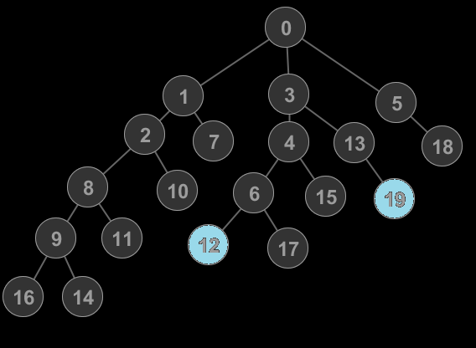

Slide 22
Pre-processing
Distance Function
Example Code
To determine the distance between two nodes in a tree, we need their respective levels and the levels of their LCA
ll dist(ll a, ll b)
{
return level[a] + level[b] - 2*level[lca(a,b)];
}
Dist( a, b) = Level[a] + Level[b] – 2*Level[LCA(a, b)]

Slide 23
Decomposition
Decompose Function
Example Code
The decompose function takes two parameters : the root of the current tree, and the parent centroid. If the current tree is the whole original tree, then the parent will be -1
To Decompose the current tree, we first find the size of the tree and each subtree, using helper function
Then we find the centroid using another helper function
We set the parent of the current centroid as the parent in the parameter
We then delete the current centroid’s connections from all of it’s connections in the original tree (parent and children)
We call decompose for each of the connections of the found centroid, passing the connected node as the root, and the found centroid as the parent
The function recurses till decomposition is complete
void decompose(ll root, ll par)
{
n_nodes = 0;
dfs_s(root, par);
ll centr = dfs_c(root, par);
c_par[centr] = par;
for(auto it = conn[centr].begin(); it != conn[centr].end(); it++)
{
conn[*it].erase(centr);
decompose(*it, centr);
}
conn[centr].clear();
}

Slide 24
Decomposition
We have to perform two dfs per centroid
First dfs roots the tree at current node, and finds the size of the tree and parallelly, the size of subtrees under all nodes
Second dfs finds the centroid of the tree rooted at current node based on the sizes calculated by the previous dfs
void dfs_s(ll u, ll p)
{
n_nodes++;
n_size[u] = 1;
for(auto it = conn[u].begin(); it != conn[u].end(); it++)
{
if(*it == p)
continue;
dfs_s(*it, u);
n_size[u] += n_size[*it];
}
}
ll dfs_c(ll u, ll p)
{
for(auto it = conn[u].begin(); it != conn[u].end(); it++)
if(*it != p && n_size[*it] > n_nodes/2)
return dfs_c(*it, u);
return u;
}

Slide 25
Sample Problem
King FooBar has recently invaded Void Land. Void Land consists of n cities. Since Void Land has a very cost effective and speedy transport system, it has only (n-1) undirected roads, which make it possible to reach any city from any other city. FooBar has to bring n generals with him in order to overlook these n cities till proper administrative officials are assigned by FooBar. King FooBar is a very suspicious person, which is natural, as he became the king of Null Land after assassinating the previous king NyanCat. King FooBar is very suspicious of his generals, and hence wants there to be no “unmonitored” contact between two generals of the same rank who are placed in any two cities in Void Land. The contact between two generals of same rank placed in two cities is “monitored” if on the shortest path between these two cities, there is atleast one city, whose general has a rank higher than them.
The generals in FooBar’s army have ranks given to them specified by letters in the alphabet : There are 26 Ranks (A to Z), such that the smaller alphabet has higher rank. Also, there are infinitely many generals in Null Land with each rank.
The input gives first n (2 < n < 10⁵). Then (n-1) lines follow, each having a, b (1 <= a, b <= n, a != b) : signifying that there is an undirected road between a and b. It is guaranteed that the given roads satisfy the conditions in the first paragraph.
The user must print n characters : ith character is the rank of the general in ith city. If a configuration that satisfies the question doesn’t exist, print “Impossible”.

Slide 26
Analysing the problem
There cannot be multiple generals with rank A
Rank A general must be placed such that all rank B generals MUST pass through the Rank A general
Consider the property of Centroid Tree : a path between any pair of nodes at level k, must pass through a node at level (k-1)
Thus, if we label the nodes according to their level in the centroid tree, (0-A, 25- Z), the condition is satisfied that any path between two node having same rank must pass through a general with lower rank
Since the max number of nodes is 10⁵, and the height of the centroid tree is log(N), which is maximum ~ 20, such a solution will always be possible

Slide 27
Sample Problem
First line of the input consists of n, the number of nodes in the tree. Initially, node 1 is black, and rest of the nodes are white. Then (n-1) lines follow. Each line has a, b : signifying that there is an undirected edge between a and b. The next line specifies Q, the number of queries. Q lines follow, specifying the queries. Each query is specified by a pair of characters : ti and vi.
If ti == 1, Query is of type 1, in which case, node vi is painted black.
If ti == 2, Query is of type 2, in which case, we have to print the min (dist(vi, u)) for any u that is black.
It is guaranteed that the graph is a tree and the queries are correct
Constraints : (2 <= n <= 10⁵, 1 <= Q <= 10⁵ )

Slide 28
Naïve Solution
A naïve solution to this problem is to store all the nodes which are turned black, and for any query of type two, iterate over all these nodes and take the minimum of the distance between them.
The complexity of finding distance between two nodes in a tree is the same as finding the lca of the two nodes, as dist = level[a] + level[b] – 2*level[ lca(a,b) ]. Which is O(logN)
Since we have Q queries, in the worst case, we may have to find the distance O(N²) times.
This means the complexity of the naïve approach is O(N²log(N))
Since N is 10⁵, this approach will obviously fail.
But, what if we could reduce the complexity by making it so that we have to do only log(N) distances per query of type 2?
This would reduce the complexity to O(Qlog²(N)). Which is of the order of 10⁷ in the worst case.
Hence such a solution will be feasible.
This is where Centroid Decomposition comes into picture.

Slide 29
Centroid Decomposition Solution
Centroid Decomposition effectively decomposes the tree into Nlog(N) paths, such that any path in the original tree is a concatenation of two of these Nlog(N) paths
For a path with an endpoint at node n in the centroid tree, the other node is either :
Completely in the subtree under n in the centroid tree
An ancestor of n in the centroid tree
A descendant of one of the ancestors of n, but not belonging to the subtree to which n belongs
A node n has maximum log(N) ancestors in the centroid tree.
So, if at each node, we store the smallest distance of a black node in it’s subtree, then path of type 1 is the value stored at n.
If the path is type 2, then ans is min (dist(n, v) ) where v is an ancestor of n in the centroid tree
If the path is type 3, then ans is min(dist(n, v) + val(v)), where v is ancestor of n in the centroid tree

Slide 30
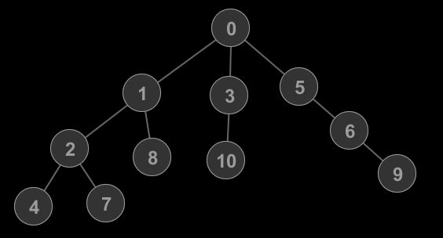
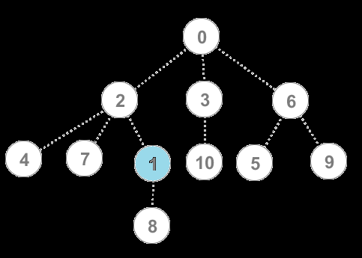
Sample Test Case
11 5
0 1
0 3
0 5
1 2
1 8
3 10
5 6
6 9
2 4
2 7
2 10
2 6
1 5
2 6
2 9
Original Tree
Centroid Tree

Slide 31
Sample Test Case
11 5
0 1
0 3
0 5
1 2
1 8
3 10
5 6
6 9
2 4
2 7
2 10
2 6
1 5
2 6
2 9
Node | Value
0 | Inf
1 | Inf
2 | Inf
3 | Inf
4 | Inf
5 | Inf
6 | Inf
7 | Inf
8 | Inf
9 | Inf
10 | Inf
Original Tree
Centroid Tree

Slide 32
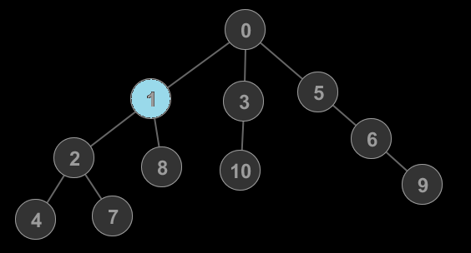
Sample Test Case
11 5
0 1
0 3
0 5
1 2
1 8
3 10
5 6
6 9
2 4
2 7
2 10
2 6
1 5
2 6
2 9
Node | Value
0 | 1
1 | 0
2 | 1
3 | Inf
4 | Inf
5 | Inf
6 | Inf
7 | Inf
8 | Inf
9 | Inf
10 | Inf
Original Tree
Centroid Tree

Slide 33
Sample Test Case
11 5
0 1
0 3
0 5
1 2
1 8
3 10
5 6
6 9
2 4
2 7
2 10
2 6
1 5
2 6
2 9
Node | Value
0 | 1
1 | 0
2 | 1
3 | Inf
4 | Inf
5 | Inf
6 | Inf
7 | Inf
8 | Inf
9 | Inf
10 | Inf
Original Tree
Centroid Tree

Slide 34
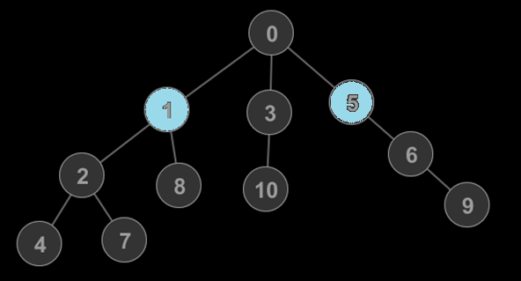
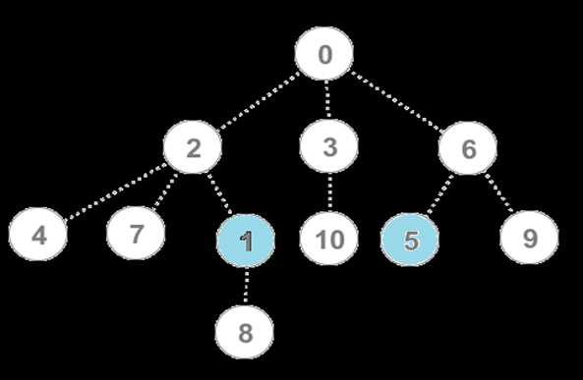
Sample Test Case
11 5
0 1
0 3
0 5
1 2
1 8
3 10
5 6
6 9
2 4
2 7
2 10
2 6
1 5
2 6
2 9
Node | Value
0 | 1
1 | 0
2 | 1
3 | Inf
4 | Inf
5 | 0
6 | 1
7 | Inf
8 | Inf
9 | Inf
10 | Inf
Original Tree
Centroid Tree

Slide 35
Sample Test Case
11 5
0 1
0 3
0 5
1 2
1 8
3 10
5 6
6 9
2 4
2 7
2 10
2 6
1 5
2 6
2 9
Node | Value
0 | 1
1 | 0
2 | 1
3 | Inf
4 | Inf
5 | 0
6 | 1
7 | Inf
8 | Inf
9 | Inf
10 | Inf
Original Tree
Centroid Tree

Slide 36
Thank You

